Slide 1
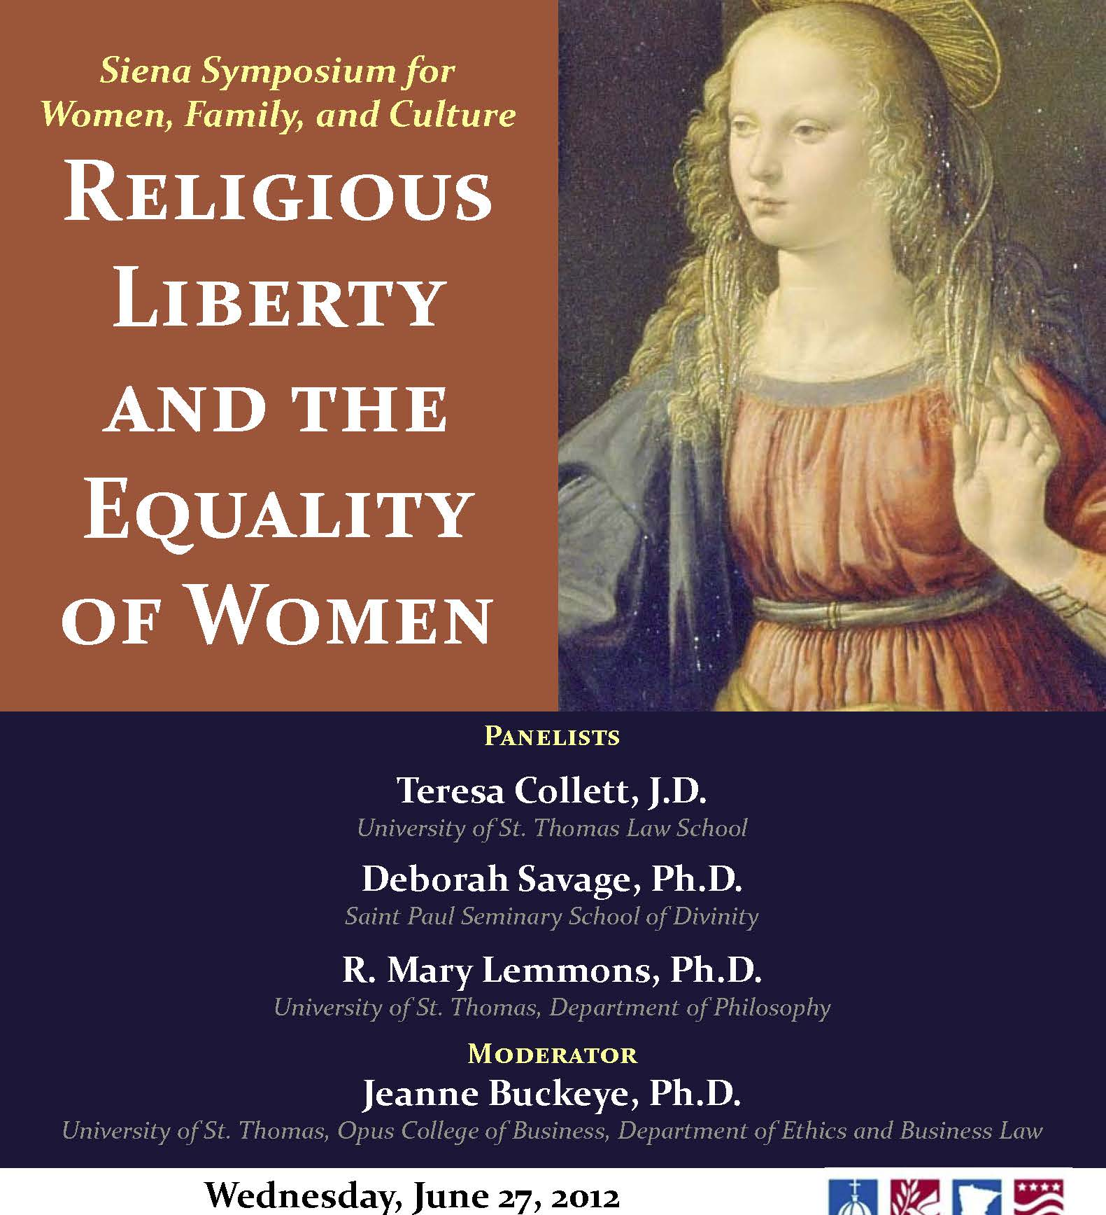
Deceits and Conceits: The False Conflict of Religious Freedom with Women’s Liberty
@copyright 2012 Teresa Collett, Deborah Savage, R Mary Lemmons, individually and collectively

